Slide 1

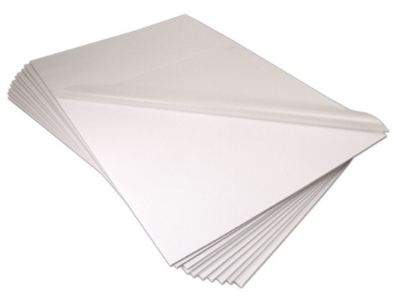

Pouch Board – Black, Matte, 37" x 49” #M37BLKST
Foam board with matte laminate attached
3/16" thick foam board
5 mil matte film attached
Low temperature adhesives safe for all inkjet and other prints
Run at 300 degrees and 1 feet per minute in roll laminators
Edge seal on the 37-inch width
Size: 37" x 49"
Color: Black
Quantity: 10
Questions? Need more information?
Contact USI’s Customer Service and Technical Support Team. We’re here to help!
Tel | (800) 282-9290; 1 (203) 245-8586
Fax | 1 (203) 245-8619
Email | customers@usi-corp.com
Web | www.usi-laminate.com
USI
98 Fort Path Road
Madison, CT 06443

