Slide 1

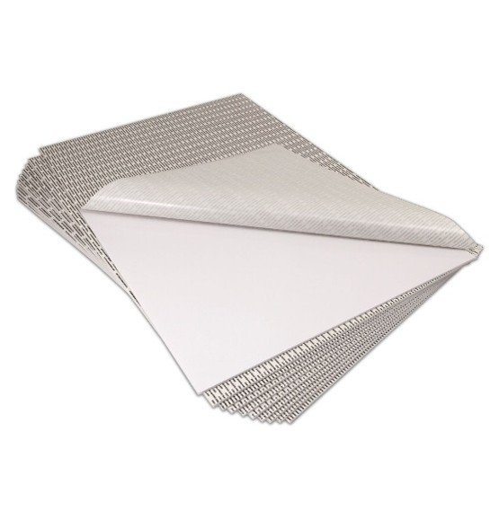

Self-Stick Adhesive Foam Board – White, 24” x 36” #550454
Foam board coated with a pressure sensitive or 'cold' adhesive
Sticky to the touch, the adhesive is a high-tack permanent adhesive for maximum hold
Boards is sturdy 3/16" thick foam board, lightweight and easy to cut
Most prints can be applied by hand with a brayer
Size: 24" x 36"
Color: White
Quantity: 25 Sheets
Questions? Need more information?
Contact USI’s Customer Service and Technical Support Team. We’re here to help!
Tel | (800) 282-9290; 1 (203) 245-8586
Fax | 1 (203) 245-8619
Email | customers@usi-corp.com
Web | www.usi-laminate.com
USI
98 Fort Path Road
Madison, CT 06443

